Slide 1


TACTICAL COMBAT CASUALTY CARE COURSE
MODULE 14: EYE INJURIES
Module 14: Eye Injuries
TCCC TIER 1
All Service Members
TCCC TIER 2
Combat Lifesaver
TCCC TIER 3
Combat Medic/Corpsman
TCCC TIER 4
Combat Paramedic/Provider

Slide 2




Module 14: Eye Injuries
TACTICAL COMBAT CASUALTY CARE (TCCC) ROLE-BASED TRAINING SPECTRUM
ROLE 1 CARE
NONMEDICAL PERSONNEL
MEDICAL PERSONNEL
YOU ARE HERE
STANDARDIZED JOINT CURRICULUM
2

Slide 3







1 x TERMINAL LEARNING OBJECTIVES
Module 14: Eye Injuries
17
Given a combat or noncombat scenario, perform assessment and initial treatment of penetrating eye trauma during Tactical Field Care in accordance with CoTCCC Guidelines.
  IDENTIFY basic care of an eye injury in accordance with CoTCCC Guidelines.
  DEMONSTRATE the application of a rigid eye shield to a trauma casualty in Tactical Field Care. (CLS T14:E52)
  DEMONSTRATE a rapid field test of visual acuity on a casualty with an eye injury.
03 x ENABLING LEARNING OBJECTIVES
#
= Terminal Learning Objectives
= Cognitive ELOs
= Performance ELOs
3

Slide 4


MARCH PAWS
Module 14: Eye Injuries
LIFE-THREATENING
AFTER LIFE-THREATENING
P A W S
_{M} MASSIVE BLEEDING
#1 Priority
_{A} AIRWAY
_{R} RESPIRATION (Breathing)
_{C} CIRCULATION
PAIN
ANTIBIOTICS
WOUNDS
SPLINTING
H
HYPOTHERMIA / HEAD INJURIES
4

Slide 5

EYE INJURIES OVERVIEW
5

Slide 6
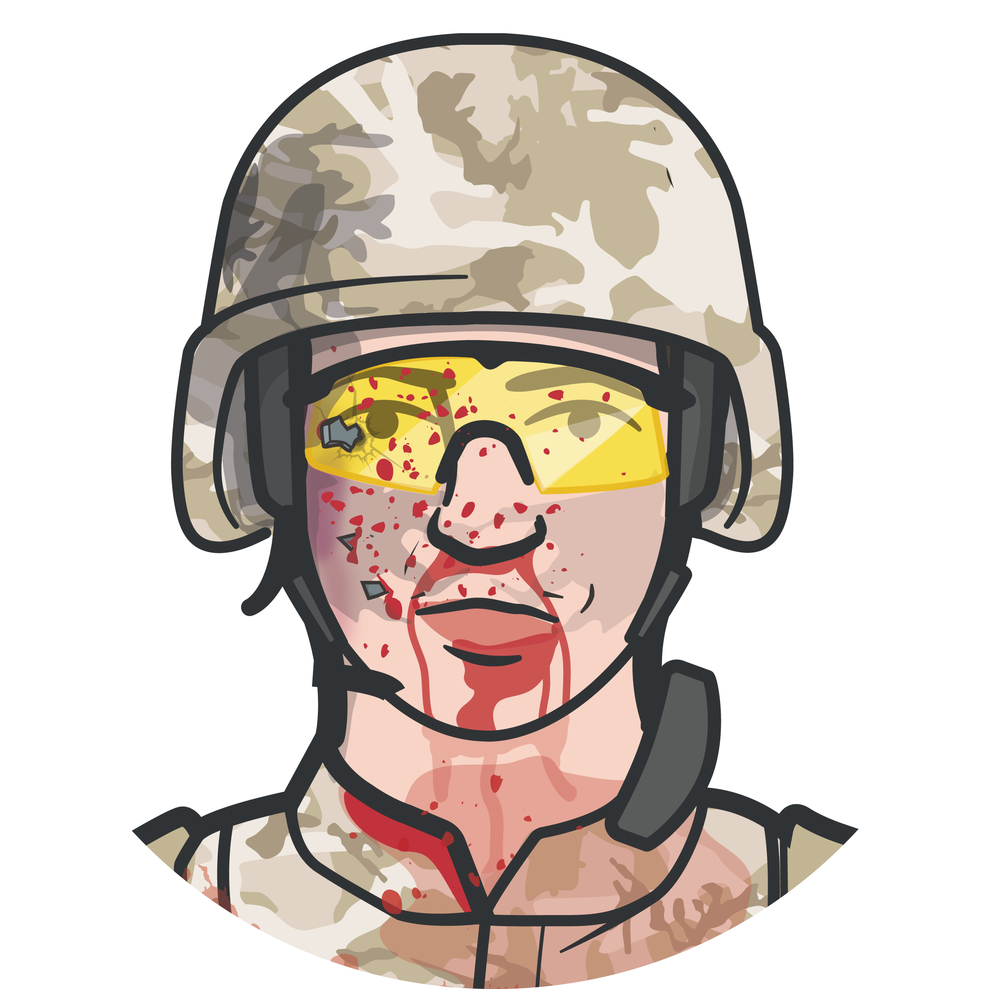
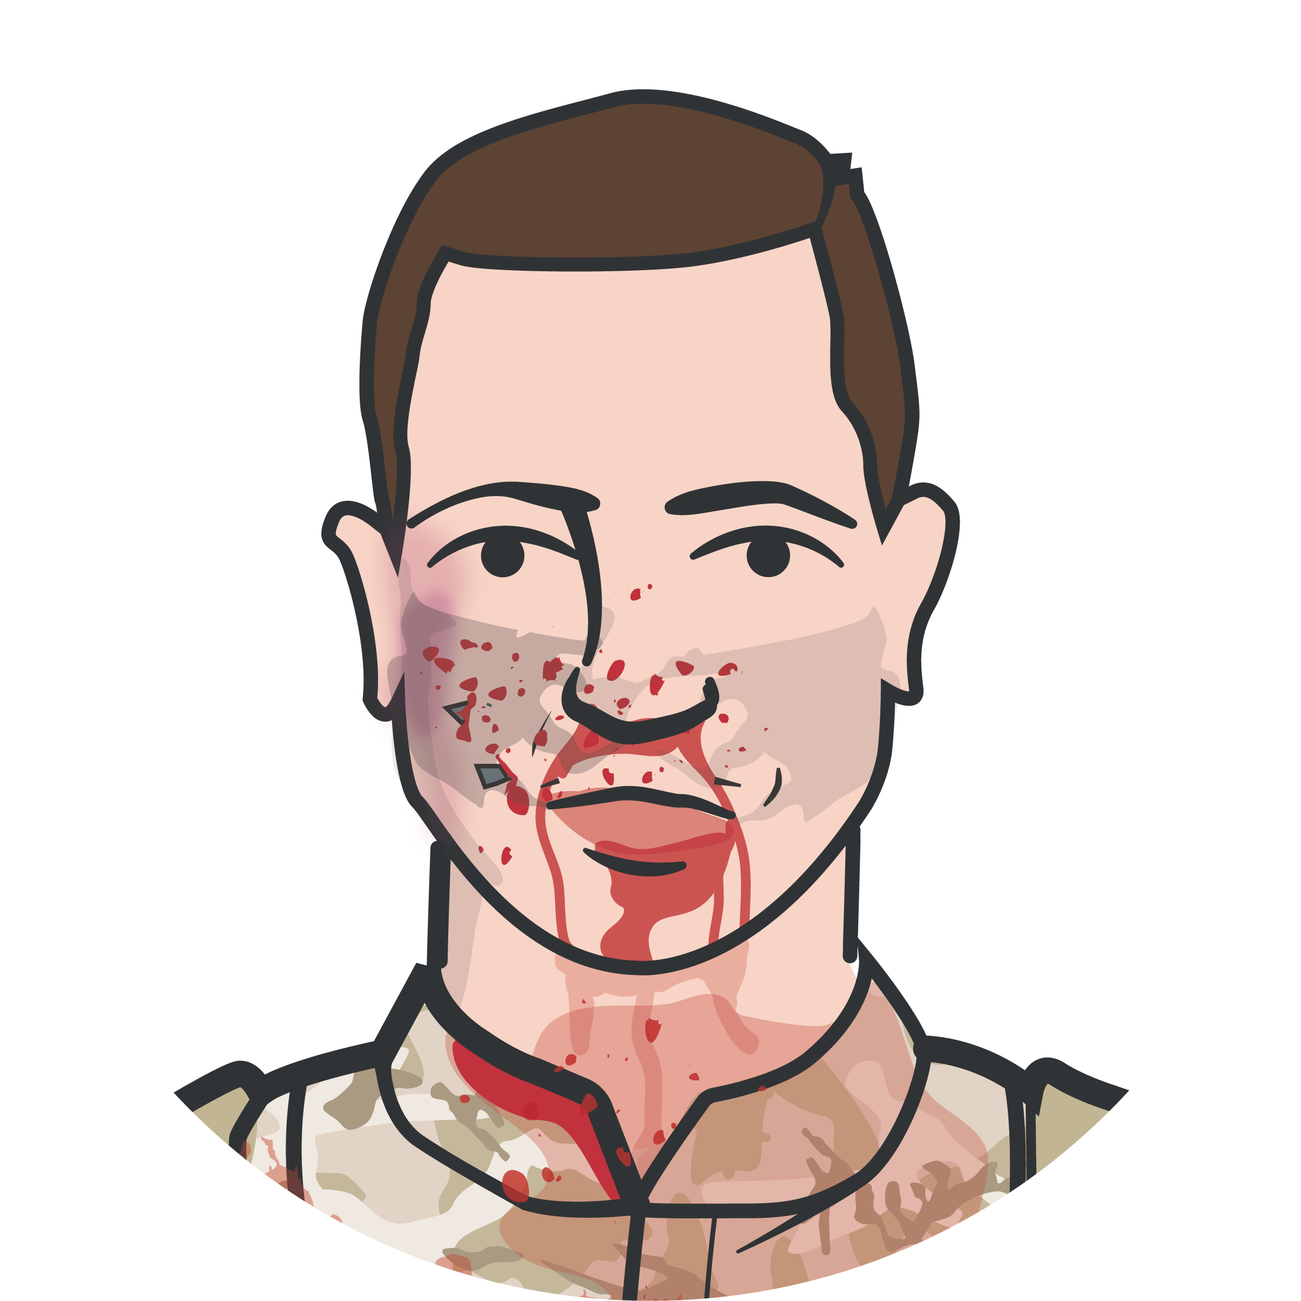
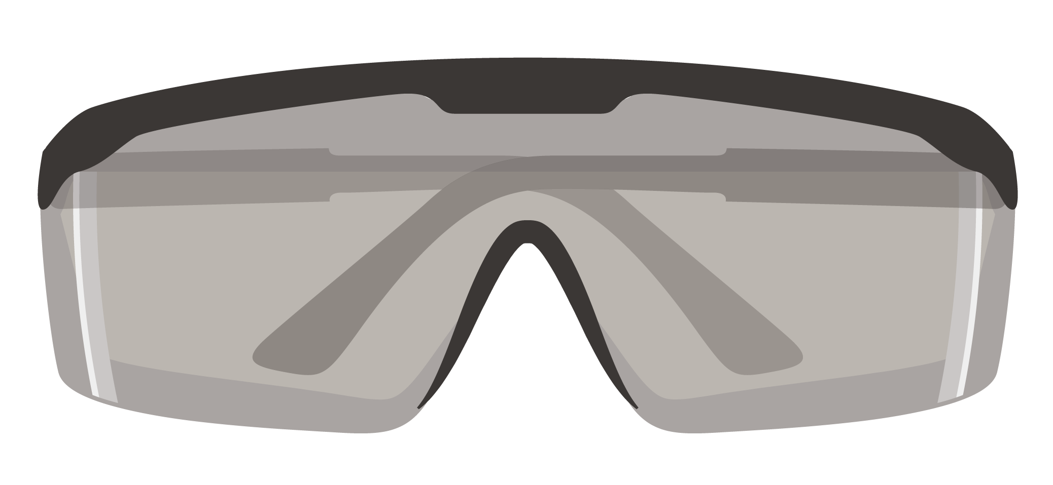
Module 14: Eye Injuries
PREVENTION PENETRATING EYE INJURY
Using tactical eyewear in the field will generally prevent the eye injury from happening in the first place!
M A R C
H
6

Slide 7



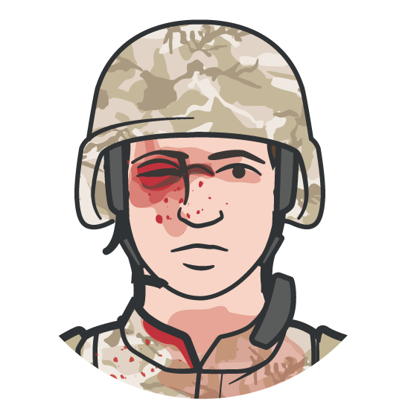
WHEN TO SUSPECT A PENETRATING EYE INJURY
Module 14: Eye Injuries
VISION VISION
1
Bleeding surrounding the eye, inside the globe of the eye, or coming from the globe of the eye
Obvious penetration of shrapnel or foreign bodies into the globe of the eye or eye socket
Objects protruding from the globe of the eye
Swelling or lacerations of the globe of the eye Protrusion of the globe of the eye from the eye socket Reduced vision and swelling of the eye area Misshapen or distorted parts of the eye from normal
2
3
4
5
6
7
M A R C
H
7

Slide 8
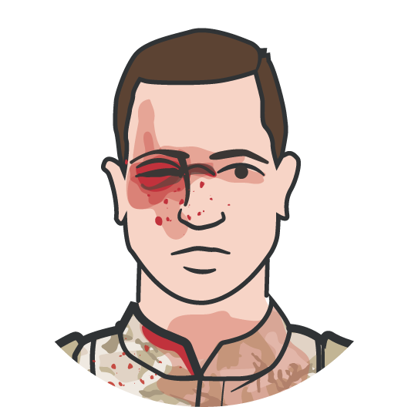


WHEN A PENETRATING EYE INJURY IS NOTED OR SUSPECTED
Module 14: Eye Injuries
1
Perform a RAPID FIELD TEST OF VISUAL ACUITY
and document findings
2
COVER THE AFFECTED EYE with a rigid eye shield (NOT a pressure patch)
3
ADMINISTER the casualty’s complete Combat Wound Medication Pack (CWMP) or IV/IO/IM antibiotics if unable to swallow
REMEMBER Document all findings (including visual acuity) and treatments on the casualty’s DD Form 1380
M A R C
H
8

Slide 9

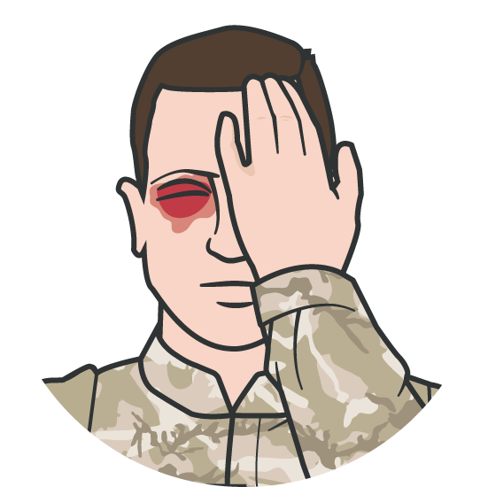



RAPID VISUAL ACUITY TESTING
Module 14: Eye Injuries
RAPID VISUAL ACUITY TESTING includes
testing the casualty’s ability to read print, count fingers, identity hand motion, and differentiate light from dark
Rapid visual acuity testing is NOT a formal vision screening with a Snellen Eye Chart
DO NOT force open a swollen eye to conduct a field visual acuity test
REMEMBER to document all findings (including visual acuity for both eyes) on a DD Form 1380 TCCC Casualty Card

Slide 10
RAPID FIELD VISUAL ACUITY TEST
Video can be found on deployedmedicine.com

Slide 11
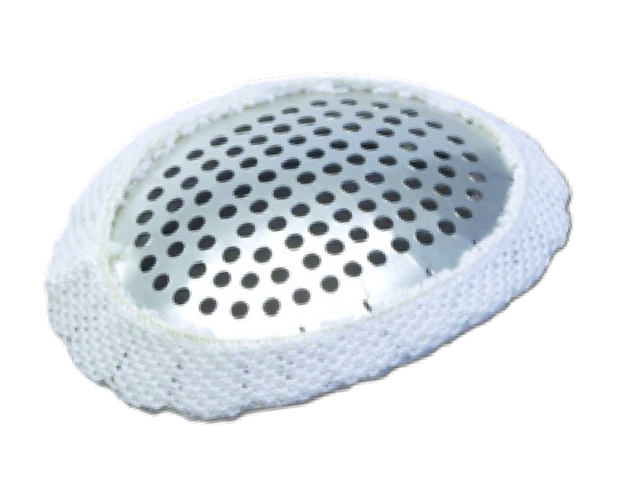
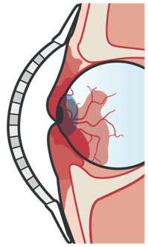
PROTECTING THE EYE
Module 14: Eye Injuries
APPLY A RIGID EYE SHIELD
Improvised eye shield can be a styrofoam/ plastic cup, to protect an injured eye
IMPORTANT!
DO NOT APPLY PRESSURE
Avoid/prevent manipulation, pressure, or additional trauma to the eye that might cause further damage
Pressure on the eye could force the interior contents of the eye out of the eyeball through a cut or laceration
Alternatively, an improvised eye shield or unit-issued protective eyewear can be used to protect an injured eye
Rigid Eye Shield
M A R C
H

Slide 12
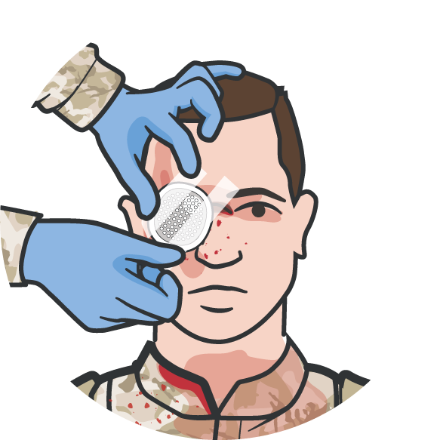
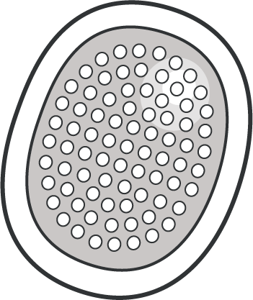
APPLYING A RIGID EYE SHIELD
Module 14: Eye Injuries
RIGID EYE SHIELD is found in the casualty’s JFAK Secure the rigid eye shield with tape at
45-degree angles across the forehead and cheek
If rigid eye shield is not available, use an improvised eye shield or tactical protective eyewear to cover and protect the injured eye
Do NOT cover both eyes unless both eyes are injured
Do NOT apply any pressure or manipulate the injured eye
If the casualty is conscious, ensure administration of the complete CWMP
M A R C
H

Slide 13
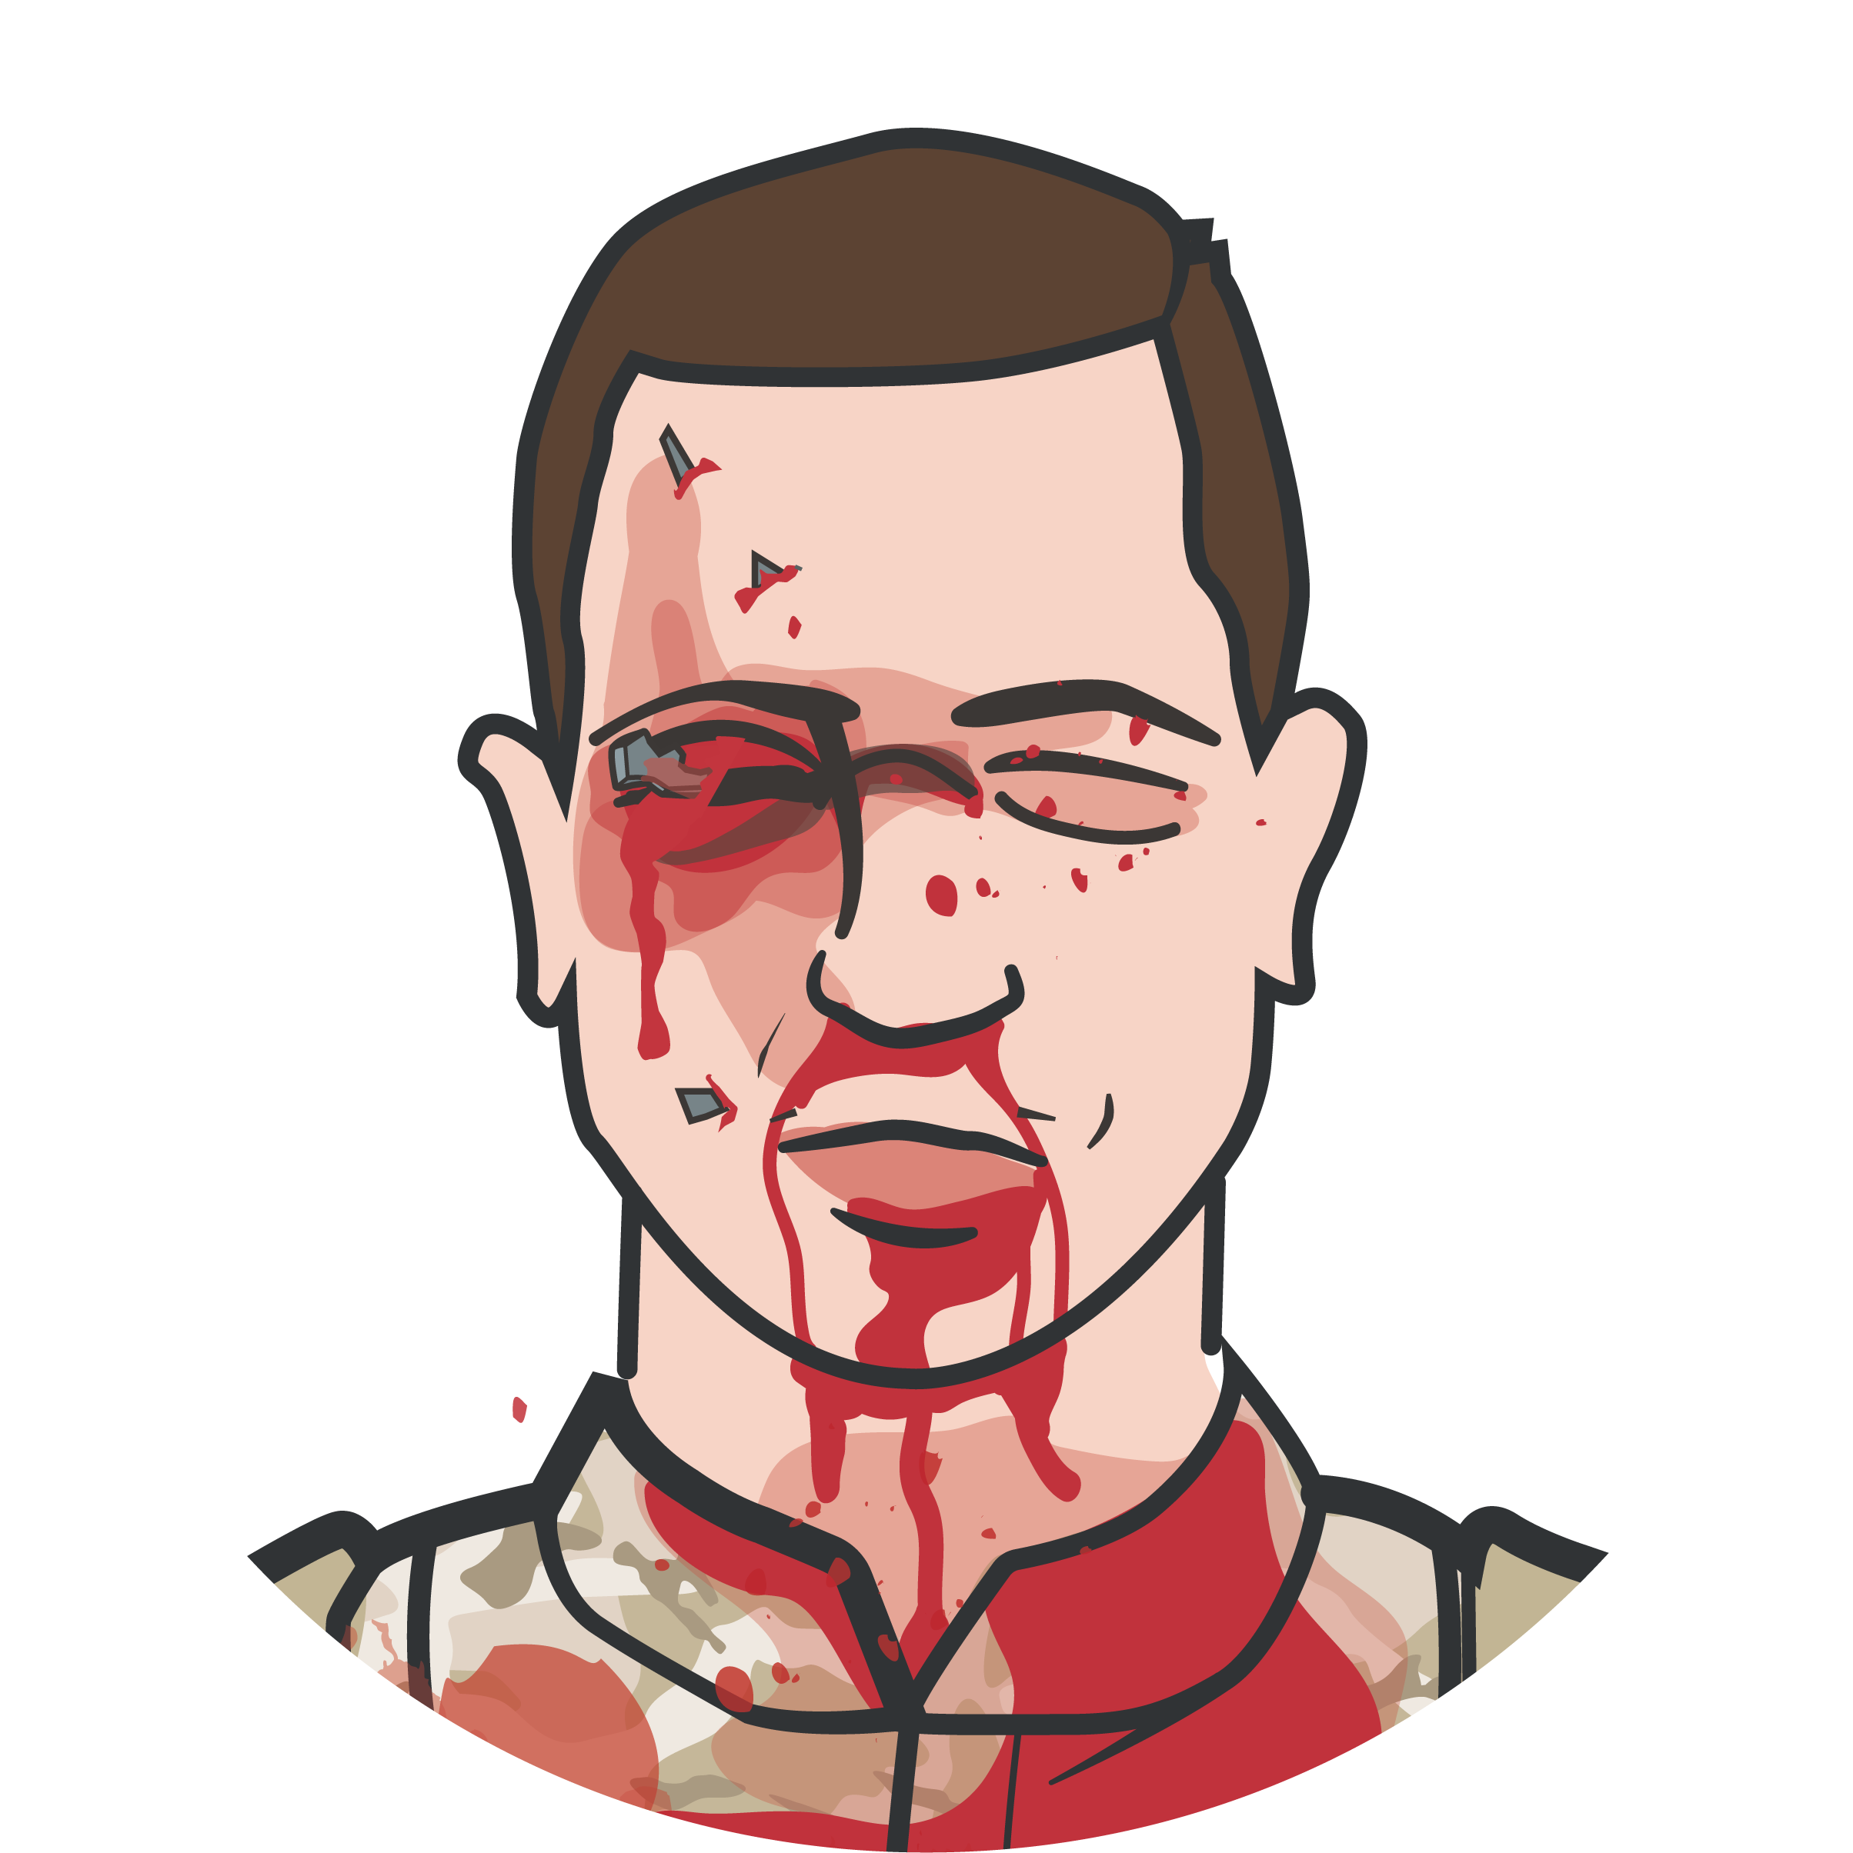
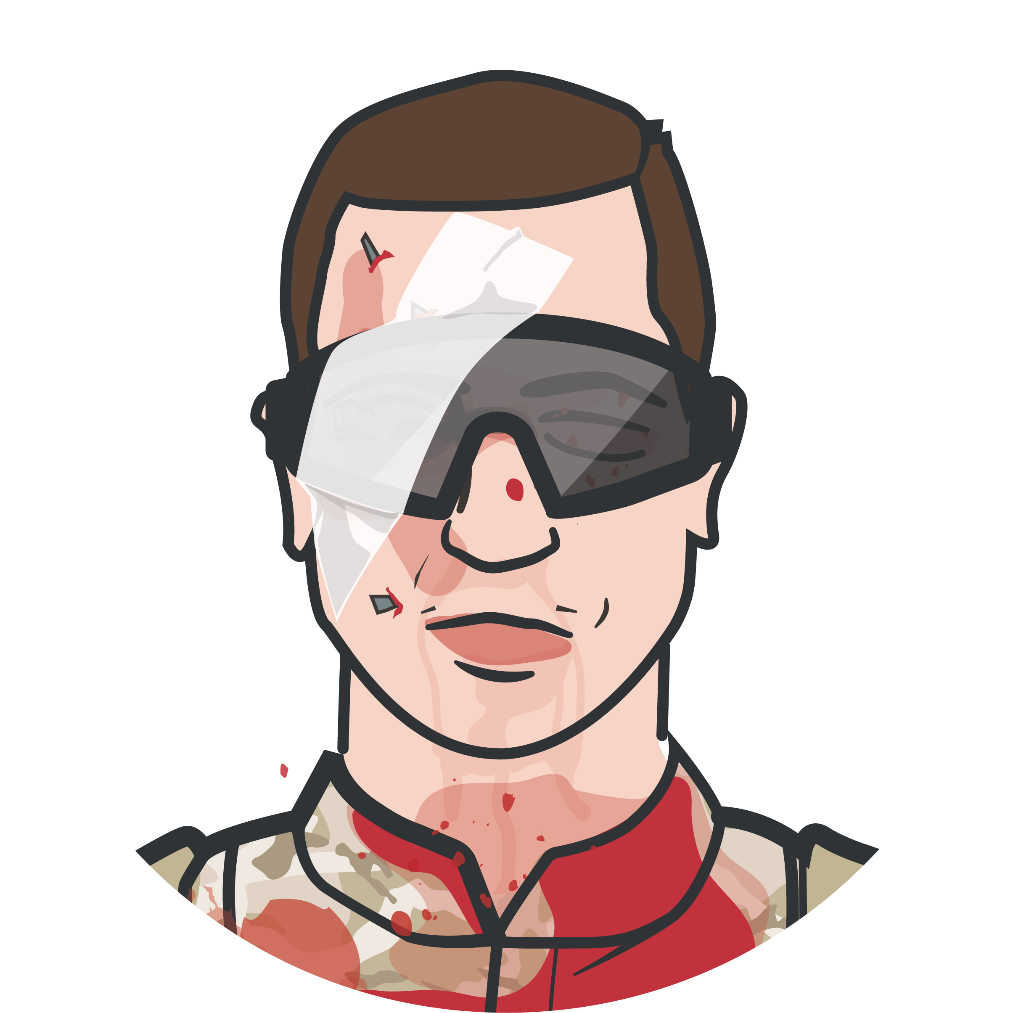
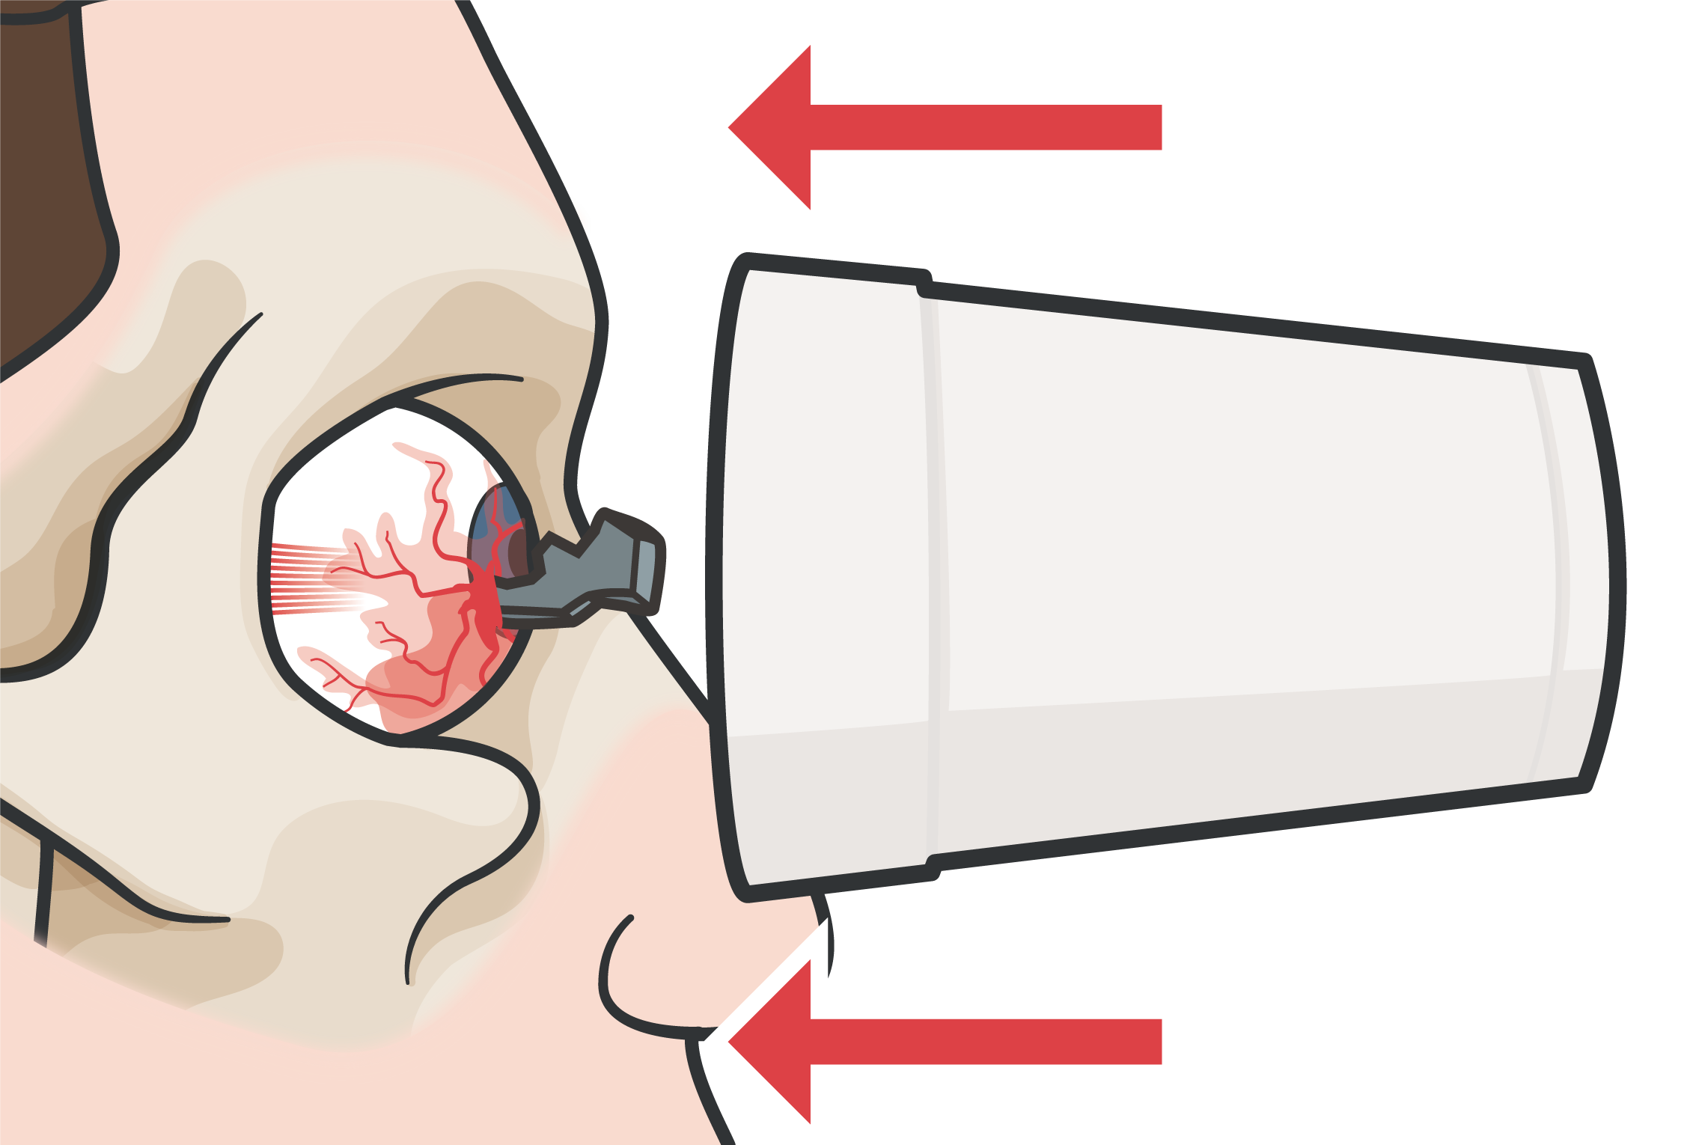
PROTECTING THE EYE
Module 14: Eye Injuries
APPLY AN IMPROVISED EYE SHIELD
Improvised eye shield can be a styrofoam/plastic cup, to protect an injured eye
IMPORTANT!
DO NOT APPLY PRESSURE
Avoid/prevent manipulation, pressure, or additional trauma to the eye that might cause further damage
Pressure on the eye could force the interior contents of the eye out of the eyeball through a cut or laceration
M A R C
H

Slide 14
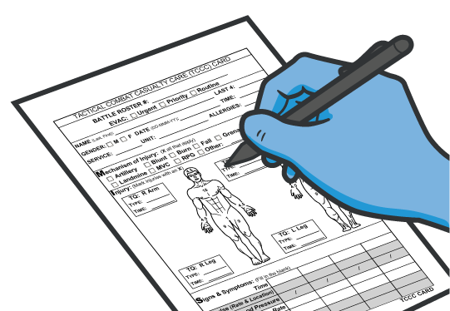
DOCUMENT TREATMENT
Module 14: Eye Injuries
Document all assessments and treatments on the DD Form 1380 and attach it to the casualty
Include results of rapid visual acuity test
Include any medications administered and the time administered
M A R C
H

Slide 15
APPLYING THE RIGID EYE SHIELD
Video can be found on deployedmedicine.com

Slide 16

SKILL STATION
Module 14: Eye Injuries
Eye Injuries (skills)
Rapid Field Visual Acuity Testing Application of a Rigid Eye Shield

Slide 17
SUMMARY
Module 14: Eye Injuries
PERFORM a rapid field test of visual acuity
COVER the affected eye with a rigid eye shield (NOT a pressure patch)
ADMINISTER the casualty’s Combat Wound Medication Pack (CWMP)
DOCUMENT all assessments (including visual acuity) and treatments on a DD Form 1380
M A R C H

Slide 18

CHECK ON LEARNING
Module 14: Eye Injuries
How should you treat a penetrating eye trauma with an impaled object?
When should a pressure dressing be used in treating traumatic eye injuries?
True or False: The Snellen Eye Chart is used for performing a rapid field visual acuity test?
True or False: Only the injured eye should be covered with an eye shield?

Slide 19



Module 14: Eye Injuries
ANY QUESTIONS?

Slide 20

REFERENCES
Module 14: Eye Injuries
TCCC: Guidelines
by JTS/CoTCCC
Updated regularly – latest edition dated 5 November 2020
These guidelines are the result of decisions made by the Committee on Tactical Combat Casualty Care as they explore evidence-based research regarding best practices
PHTLS: Military Edition, Chapter 25
by NAEMT
Prehospital Trauma Life Support, Military Ninth Edition
NOV 2020

